Slide 1



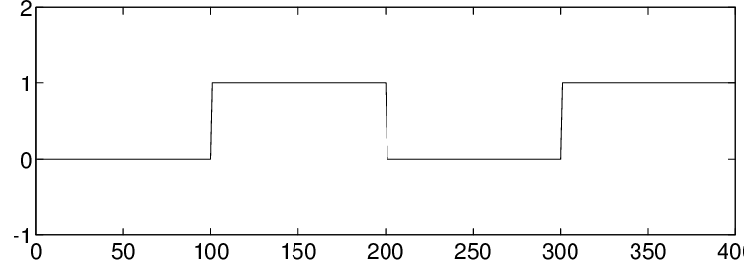
DEVS Simulator (fabrication model)
Data Processing
Train/Test split
Manual Input
Machine State Profiles
(Idle/Active)
Temporal Fusion
Transformer
Raw simulation data

